Slide 1
RISE to the Challenges of AI Systems
Joseph E. Gonzalez
Assistant Professor, UC Berkeley
jegonzal@cs.berkeley.edu
Notes:
A new lab we are starting at UC Berkeley, as a continuation to Amplab
Amplab is a systems group at Berkeley that created Spark, Mesos and Tachyon, big data systems with a lot of impact. How many know of spark? It is used by hundreds of companies
These labs last 5-6 years and a new lab is created at the end so that we can always be on the next wave
So I will tell you about the new lab, which we believe to be the next big impactful vision
These labs bring together faculty from different disciplines that can help tackle that problem. We collaborate to solve this.
Main people are… a bunch of s ...
An important component of ours is partnering with companies.
Amplab has learned a lot from companies from the feedback they gave, companies got to use products, have students intern, and overall just have a good synergetic collaboration
Speaking of which, please give us any feedback you think of because we are still shaping the next lab
Authors

Slide 2
Big
Data
Training
Big Model
Large-Scale parallel and distributed systems

Slide 3
Big
Data
Training
Big Model
Timescale: minutes to days
Systems: offline and batch optimized
Heavily studied ... primary focus of the ML research

Slide 4

Learning
Big
Data
Training
Big Model
VW

Slide 5



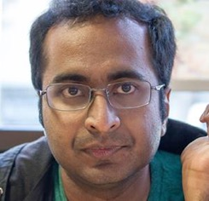
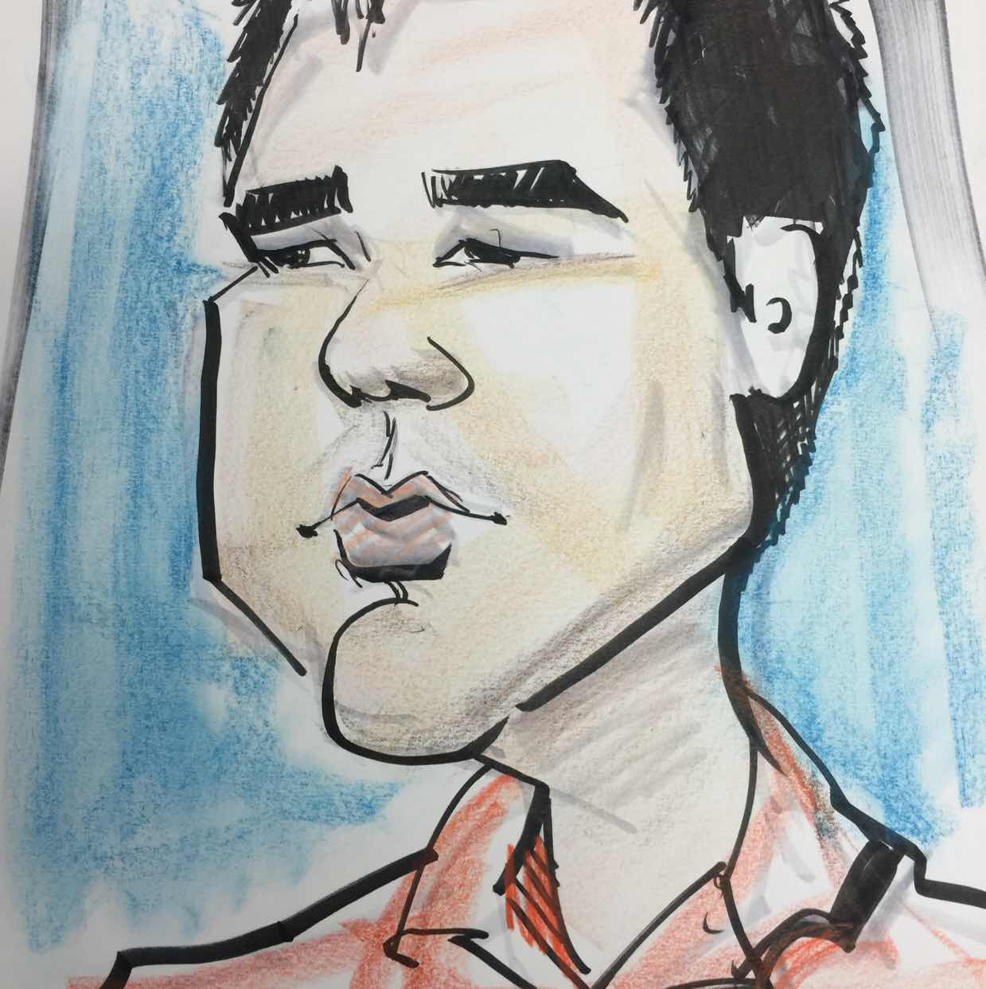

Temgine Distributed Time Series Analysis of Asynchronously Sampled Data
Francois
Billetti
Evan
Sparks
Xin
Wang
Paris Model Based Optimal Virtual Machine Selection
Neeraja Yadwadkar
Bharath
Hariharan
Randy Katz
Deep Code Completion Neural architectures for program analysis and synthesis
Xin
Wang
Chang
Liu
Dawn
Song

Slide 6
How to do Research in AI Systems
Manage Complexity
seek parsimony in system design
great systems research is often about what features are taken away
Do a few things well and be composable
Identify Tradeoffs
With each design decision what do you gain and lose?
What trade-offs are fundamental?
Evaluate your System
Positive: How fast and scalable is it and why?
Negative: When does it fail and what are it’s limitations?

Slide 7



Hemingway* Modeling Throughput and Convergence for ML Workloads
Shivaram
Venkataraman
Xinghao
Pan
Zi
Zheng
What is the best algorithm and level of parallelism for an ML task?
Trade-off: Parallelism, Coordination, & Convergence
Research challenge: Can we model this trade-off explicitly?
ML Metric
We can estimate I from data on many systems
Iter. / Sec.
Loss
p=1
Systems Metric
p=4
We can estimate L from data for our problem
Cores
Iteration
Iterations per second as a function of cores p
Loss as a function of iterations i and cores p
*follow-up work to Shivaram’s Ernest System in NSDI’16
Notes:
more parallelism doesn’t not imply faster learning
can depend on loss and properties of the data

Slide 8
Hemingway* Modeling Throughput and Convergence for ML Workloads
Shivaram
Venkataraman
Xinghao
Pan
Zi
Zheng
What is the best algorithm and level of parallelism for an ML task?
Trade-off: Parallelism, Coordination, & Convergence
Research challenge: Can we model this trade-off explicitly?
Loss as a function of iterations i and cores p
Iterations per second as a function of cores p
How long does it take to get to a given loss?
Given a time budget and number of cores which algorithm will give the best result?
*follow-up work to Shivaram’s Ernest System in NSDI’16
Notes:
more parallelism doesn’t not imply faster learning
can depend on loss and properties of the data

Slide 9
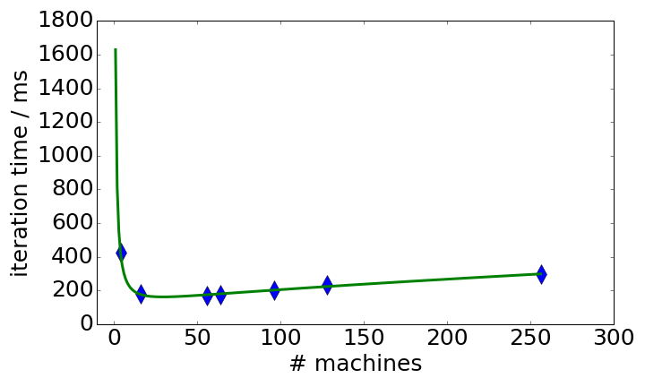
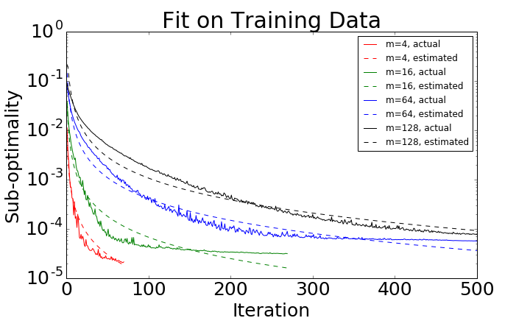
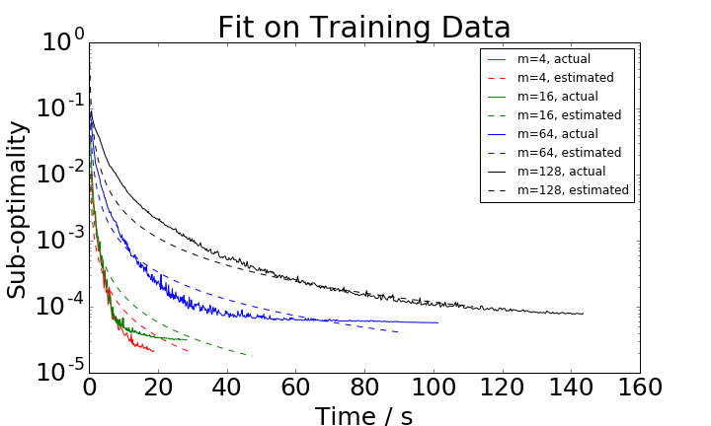
System Performance as a function of Parallelism
Convergence as a function of Parallelism and Iterations
Time Per. Iteration
Training Loss
Parallelism
Iteration
Convergence as a fn. of Time and Parallelism
Hemingway: Modeling Distributed Optimization Algorithms.
Xinghao Pan, Shivaram Venkataraman, Zizheng Tai, Joseph Gonzalez.
NIPS’16 ML-Sys Workshop.
Training Loss

Slide 10
Take away …
try to decouple
System
Improvements
Algorithm
Improvements
use data collection + sparse modeling to understand your system

Slide 11
Learning
Big
Data
Training
Big Model
VW

Slide 12
Big
Data
Training
Big Model

Slide 13
Learning
?
Big
Data
Training
Big Model

Slide 14

Learning
Big
Data
Conference
Papers
Training
Big Model
Dashboards and
Reports

Slide 15
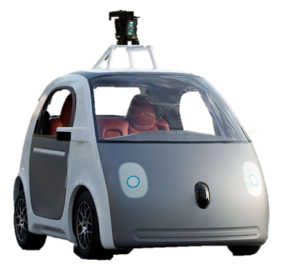
Learning
Conference
Papers
Big
Data
Training
Dashboards and
Reports
Big Model
Drive Actions

Slide 16
Learning
Conference
Papers
Dashboards and
Reports
Big
Data
Training
Big Model
Drive Actions

Slide 17
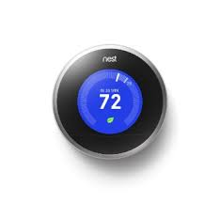


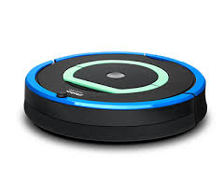


Drive Actions
Learning
Big
Data
Training
Big Model

Slide 18
Learning
Inference
Big
Data
Training
Big Model

Slide 19
Learning
Inference
Big
Data
Query
Training
?
Decision
Big Model
Application

Slide 20
Inference
Learning
Query
Big
Data
Training
Decision
Big Model
Application
Often overlooked
Timescale: ~10 milliseconds
Billions of Queries a Day → Costly

Slide 21
why is challenging?
Inference
Need to render low latency (< 10ms) predictions for complex
Models
Queries
Features
SELECT * FROM
users JOIN items, click_logs, pages WHERE …
Top K
under heavy load with system failures.

Slide 22


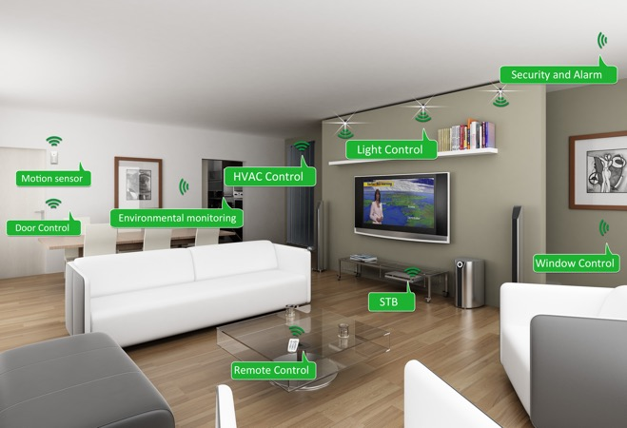
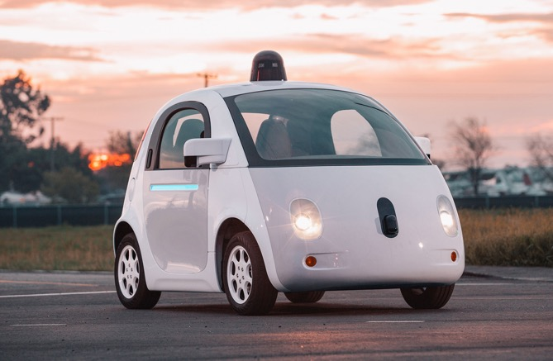
is moving beyond the cloud
Inference
Augmented Reality
Home Security
Home Automation
Mobile
Assistants
Self Driving Cars
Personal Robotics

Slide 23




is moving beyond the cloud
Inference
Opportunities
Reduce latency and improve privacy
Address network partitions
Research Challenges
Minimize power consumption
Limited hardware & long life-cycles
Develop new hybrid models to leverage the cloud and edge devices

Slide 24
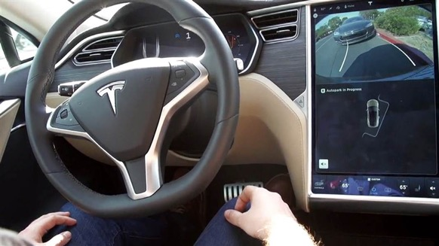
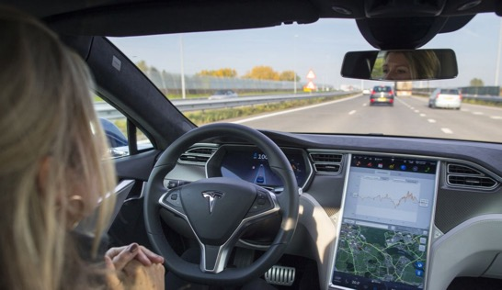
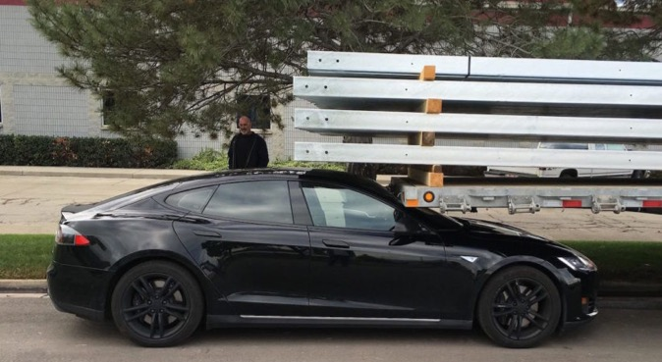
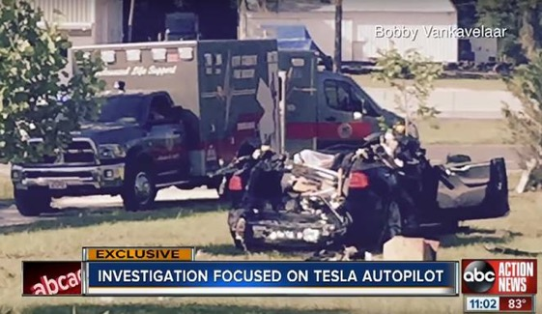
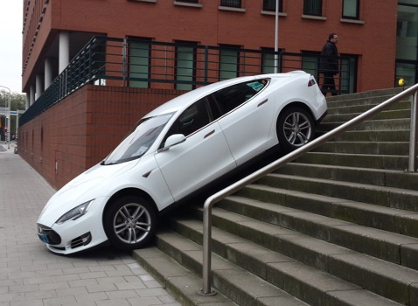
Robust is critical
Inference
Self “Parking” Cars
Self “Driving” Cars
Chat AIs

Slide 25
Learning
Inference
Big
Data
Query
Training
Decision
Big Model
Application
Feedback

Slide 26
Learning
Inference
Training
Decision
Big
Data
Timescale: hours to weeks
Often re-run training
Sensitive to feedback loops
Application
Feedback

Slide 27
Why is challenging?
Closing the Loop
Implicit and Delayed Feedback
Self Reinforcing
Feedback Loops
World Changes
at varying rates

Slide 28
Learning
Inference
Big
Data
Query
Training
Responsive
(~10ms)
Adaptive
(~1 seconds)
Decision
Big Model
Application
Feedback

Slide 29
Learning
Inference
Adaptive
(~1 seconds)
Responsive
(~10ms)
?
Notes:
Adaptive is hard because of the complex training process that typically revisits the entire data set.
Responsive is hard because of complex often personalized models a elaborate queries

Slide 30
Learning
Inference
Adaptive
(~1 seconds)
Responsive
(~10ms)
Secure
Notes:
Adaptive is hard because of the complex training process that typically revisits the entire data set.
Responsive is hard because of complex often personalized models a elaborate queries

Slide 31
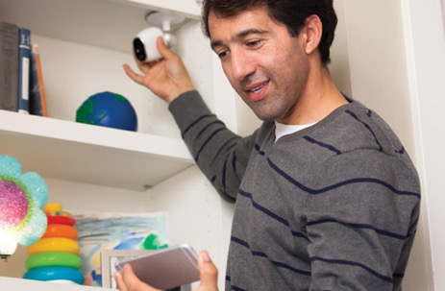
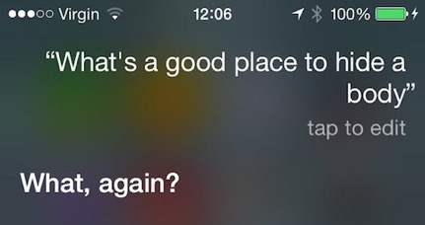
Intelligence in Sensitive Contexts
Augmented Reality
Home Monitoring
Voice Technologies
Medical Imaging
Protect the data, the model, and the query

Slide 32
Protect the data, the model, and the query
High-Value Data is Sensitive
Medical Info.
Home video
Finance
Models capture value in data
Core Asset
Sensitive
Data
Queries can be as sensitive as the data

Slide 33
Opaque: Analytics on Secure Enclaves
Exploit hardware support to enable computing on encrypted data
Today: prototype system running in Apache Spark
support SQL queries in untrusted cloud
~50% reduction in perf.
Future: enable prediction serving on enc. queries
Wenting et al. (NSDI’17)

Slide 34
Adaptive
Responsive
Secure
Notes:
Adaptive is hard because of the complex training process that typically revisits the entire data set.
Responsive is hard because of complex often personalized models a elaborate queries

Slide 37
A Low-Latency Online Prediction Serving System
Clipper
NSDI’17
Daniel Crankshaw
Xin Wang
Giulio Zhou
Michael J. Franklin
Joseph E. Gonzalez
Ion Stoica

Slide 38
Learning
Inference
Big
Data
Query
Training
Decision
Application
Feedback

Slide 39
Learning
Inference
Slow Changing
Parameters
Fast Changing Parameters
Big
Data
Query
Feedback
Training
Fast
Decision
Application
Feedback
Slow

Slide 40
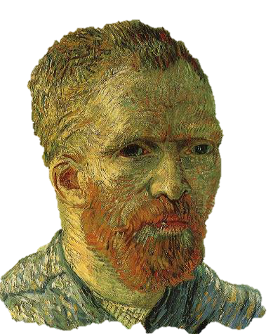
Hybrid Offline + Online Learning
Update “feature” functions offline using batch solvers
Leverage high-throughput systems (Tensor Flow)
Exploit slow change in population statistics
Update the user weights online:
Simple to train + more robust model
Address rapidly changing user statistics

Slide 41
Common modeling structure
Matrix Factorization
Deep Learning
Ensemble
Methods
Items
Ratings
Users
Input

Slide 42
Clipper Online Learning for Recommendations (Simulated News Rec.)
Partial Updates: 0.4 ms
Retraining: 7.1 seconds
>4 orders-of-magnitude faster adaptation
Error
Partial Updates
Full Updates
Examples

Slide 43
Learning
Inference
Big
Data
Slow Changing
Parameters
Fast Changing Parameters
Feedback
Fast
Application
Feedback
Slow

Slide 44
Learning
Inference
Slow Changing
Parameters
Clipper
Fast Changing Parameters
Big
Data
Feedback
Fast
Caffe
Application
Feedback
Slow

Slide 45







Clipper Serves Predictions across ML Frameworks
Fraud Detection
Content
Rec.
Personal
Asst.
Robotic
Control
Machine
Translation
Clipper
VW
Create
Caffe

Slide 46
Clipper
Key Insight: The challenges of prediction serving can be addressed between end-user applications and machine learning frameworks
Caffe
VW
Create
As a result, Clipper is able to:
hide complexity by
providing a common interface to applications
bound latency and maximize throughput
through caching, adaptive batching, model replication
enable robust online learning and personalization
through model selection and ensemble algorithms
without modifying machine learning frameworks or front-end applications
Notes:
By interposing between applications and ML frameworks we we can reduce complexity and latency, improve throughput, and enable generic online learning and personalization

Slide 47
Clipper Architecture
Fraud Detection
Content
Rec.
Personal
Asst.
Robotic
Control
Machine
Translation
Clipper
VW
Create
Caffe

Slide 48
Clipper Architecture
Applications
Predict
RPC/REST Interface
Observe
Clipper
VW
Create
Caffe

Slide 49
Clipper Architecture
Applications
Predict
RPC/REST Interface
Observe
Clipper
RPC
RPC
RPC
RPC
Model Wrapper (MW)
MW
MW
MW
Caffe
VW
Create
Notes:
Jump to slide 61

Slide 50
Clipper Architecture
Applications
Predict
RPC/REST Interface
Observe
Clipper
Improve accuracy through bandit methods, ensembles, online learning, and personalization
Model Selection Layer
Model Abstraction Layer
Provide a common interface to models
while bounding latency and maximizing throughput.
RPC
RPC
RPC
RPC
Model Wrapper (MW)
MW
MW
MW
Caffe

Slide 51
Clipper Architecture
Applications
Predict
RPC/REST Interface
Observe
Clipper
Model Selection Layer
Anytime Predictions
Model Abstraction Layer
Caching
Adaptive Batching
RPC
RPC
RPC
RPC
Model Wrapper (MW)
MW
MW
MW
Caffe
Notes:
Jump to slide 61

Slide 52
Applications
Predict
RPC/REST Interface
Observe
Clipper
Model Selection Layer
Anytime Predictions
Model Abstraction Layer
Caching
Adaptive Batching
RPC
RPC
RPC
RPC
Model Wrapper (MW)
MW
MW
MW
Caffe

Slide 53
Applications
Predict
RPC/REST Interface
Observe
Clipper
Model Selection Layer
Anytime Predictions
Model Abstraction Layer
Caching
Model Abstraction Layer
Adaptive Batching
RPC
RPC
RPC
RPC
Model Wrapper (MW)
MW
MW
MW
Caffe
Provide a common interface to models while bounding latency and maximizing throughput.
Models run in separate processes as Docker containers
Resource isolation

Slide 54
Applications
Predict
RPC/REST Interface
Observe
Clipper
Model Selection Layer
Anytime Predictions
Model Abstraction Layer
Caching
Model Abstraction Layer
Adaptive Batching
RPC
RPC
RPC
RPC
RPC
RPC
Model Wrapper (MW)
MW
MW
MW
MW
MW
Caffe
Provide a common interface to models while bounding latency and maximizing throughput.
Models run in separate processes as Docker containers
Resource isolation
Scaling under heavy load
Problem: frameworks optimized for batch processing not latency

Slide 55
Adaptive Batching to Improve Throughput
Why batching helps:
Optimal batch depends on:
hardware configuration
model and framework
system load
Clipper Solution:
be as slow as allowed…
Application specifies latency objective
Clipper uses TCP-like tuning algorithm to increase latency up to the objective
A single
page load may generate
many queries
Hardware
Acceleration
Helps amortize
system overhead

Slide 56
Tensor Flow Conv. Net (GPU)
Optimal Batch Size
Throughput
Latency (ms)
P99 Latency
Throughput (Queries Per Second)
Latency
Deadline
Avg. Latency
Batch Sizes (Queries)

Slide 57
Throughput
(QPS)
Better
No-Op
Kernel SVM
(SK-learn)
Random Forrest
(SK-learn)
Linear SVM
(PySpark)
Linear SVM
(SK-learn)
Log. Regression
(SK-Learn)
P99 Latency
(𝜇s)
Better
20000 is
Good Enough

Slide 58
Throughput
(QPS)
Better
P99 Latency
(𝜇s)
Better
20000 is
Good Enough
No-Op
Kernel SVM
(SK-learn)
Random Forrest
(SK-learn)
Linear SVM
(PySpark)
Linear SVM
(SK-learn)
Log. Regression
(SK-Learn)

Slide 59
Overhead of modularity?
Better
Better
40000 is
Good Enough
The decoupled Clipper architecture can be as fast as the in-process approach adopted by TensorFlow-Serving

Slide 60
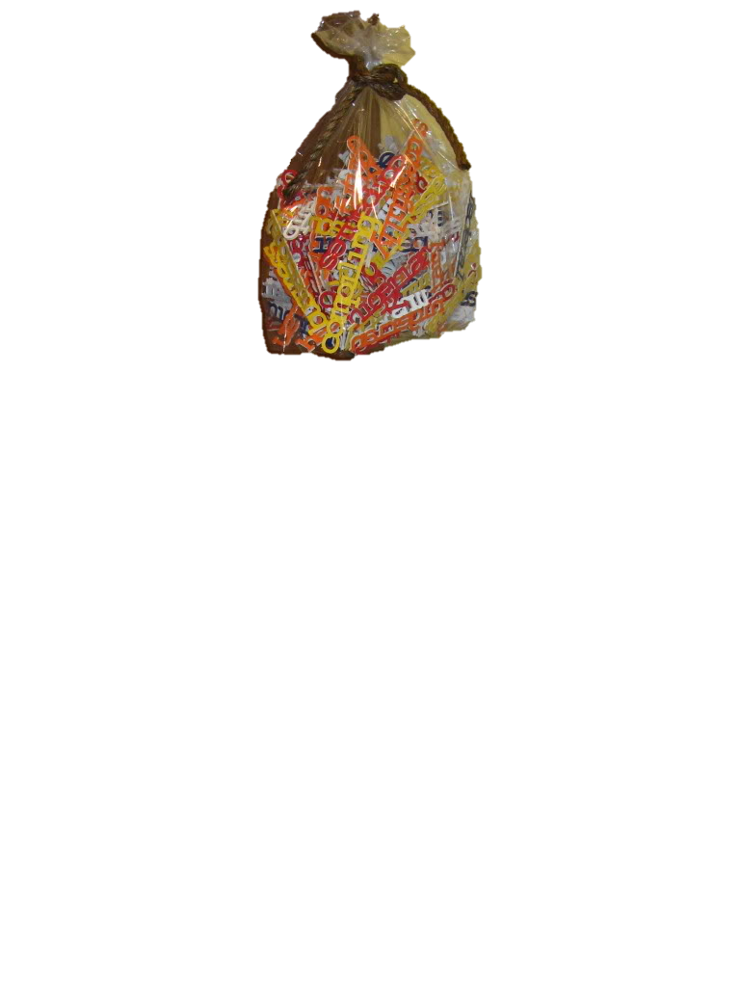
Approximate Caching to Reduce Latency
Opportunity for caching
Need for approximation
Clipper Solution: Approximate Caching
apply locality sensitive hash functions
Popular items may be evaluated frequently
Hash 1
Cache Hit
?
Hash 2
Cache Miss
Bag-of-Words
Model
?
Images
Cache Hit
?
Error
High Dimensional and continuous valued queries have low cache hit rate.

Slide 61
Clipper Architecture
Applications
Predict
RPC/REST Interface
Observe
Clipper
Model Selection Layer
Selection Policy
Model Abstraction Layer
Caching
Adaptive Batching
RPC
RPC
RPC
RPC
Model Wrapper (MW)
MW
MW
MW
Caffe
Notes:
Jump to slide 61

Slide 62
Applications
Predict
RPC/REST Interface
Observe
Clipper
Model Selection Layer
Selection Policy
Goal:
Maximize accuracy through bandits, ensembles, online learning, and personalization
Incorporate feedback in real-time to achieve:
robust predictions by adaptively combining predictions from multiple models and frameworks
online learning and personalization by selecting and personalizing predictions in response to feedback

Slide 63
Model Selection Policy
Improves prediction accuracy by:
Combining predictions from multiple frameworks
Ensemble methods
Incorporate real-time feedback
Personalized ensembles
Bandit algorithms
Estimates confidence of predictions
Agreement between models
Clipper
Model Selection Layer
Caffe
Selection Policy

Slide 64
Ensemble Prediction Accuracy (ImageNet)
System | Model | Error Rate | #Errors
Caffe | VGG | 13.05% | 6525
Caffe | LeNet | 11.52% | 5760
Caffe | ResNet | 9.02% | 4512
TensorFlow | Inception v3 | 6.18% | 3088
sequence of pre-trained models
Notes:
ImageNet public validation dataset (50K examples)
1000 categories

Slide 65
Ensemble Prediction Accuracy (ImageNet)
System | Model | Error Rate | #Errors
Caffe | VGG | 13.05% | 6525
Caffe | LeNet | 11.52% | 5760
Caffe | ResNet | 9.02% | 4512
TensorFlow | Inception v3 | 6.18% | 3088
Clipper | Ensemble | 5.86% | 2930
5.2% relative improvement in prediction accuracy!
Notes:
ImageNet public validation dataset (50K examples)

Slide 66
Ensemble Methods Create Stragglers
Slow Changing
Model
Clipper
✓
20ms
Fast Changing Linear Model
✓
Application
Caffe
Solution:
Replace missing prediction with an estimator
E[ (x) ]
Notes:
Skip to 61 if needed

Slide 67
Anytime Predictions
Fast Changing Model
w_{scikit}
+
w_{TF}
+
w_{Caffe}
✓
✓
Slow Changing
Model
Caffe
Notes:
Skip to 48 if needed

Slide 68
Anytime Predictions
Tolerates some loss of models
Depends heavily on ensemble
Notes:
Sk-learn random forrests
Accuracy was on Timit models

Slide 69
Ensemble’s to Estimate Confidence

Slide 70
Clipper is a prediction serving system that spans multiple ML Frameworks and is designed to
Clipper
Caffe
VW
Create
to simplifying model serving
bound latency and increase throughput
and enable real-time learning and personalization
across machine learning frameworks
“Clipper: A Low-Latency Online Prediction Serving System”
https://github.com/ucbrise/clipper (open source)

Slide 71
Ongoing Clipper Subprojects
Adaptive Batching for Prediction
Leverage internal data-parallelism and hardware acceleration
Approximate Caching
Detect “similar” queries and re-use cached predictions
Prediction Cascades
Automatically deriving cascades of increasingly GPU intensive models
RL/Control
Serving and updating RL policies based on feedback
Scheduling and resource allocation
Reduce the need to over-provision for bursty workloads

Slide 72


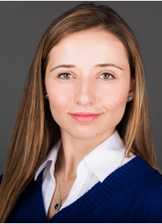



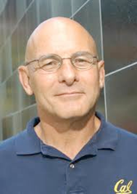





We are developing new technologies that will enables applications to make low-latency intelligent decision on live data with strong security guarantees.

Slide 73
Adaptive
Responsive
Secure
Notes:
Adaptive is hard because of the complex training process that typically revisits the entire data set.
Responsive is hard because of complex often personalized models a elaborate queries

